Slide 1



Intoxicating Substance Consumption Analysis using Power BI
Submitted By Supervised By
Jay Dev [12322566] Dr. Mithilesh Kumar Dubey Professor

Slide 2

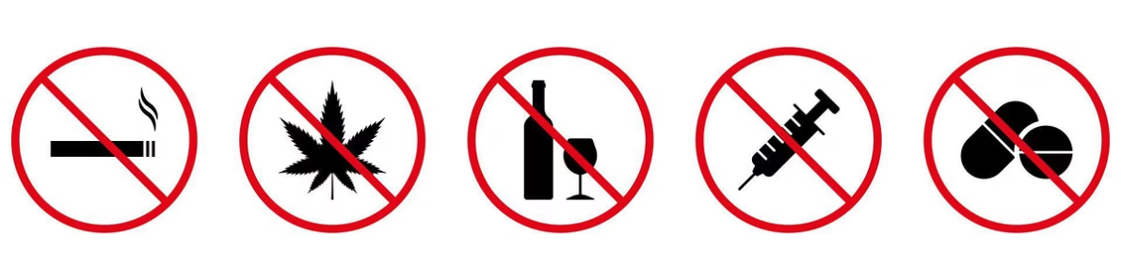
Project Overview and Objectives
Data Collection
Data Transformation
Goal
Interactive Google Form for real-time responses
Power BI dashboards to visualize key behaviors
Patterns in the use of intoxicating substances

Slide 3

Understanding Substance Use Patterns
Growing Concern
Substance use impacts individuals and communities
Need for accessible data insights
Digital Approach
Real-time interactive data collection
Power BI boosts dashboard accessibility

Slide 4

Key Concepts to Know
Substance Use
Consumption patterns and effects
Power BI
Data visualization tool
Behavioral Analysis
Identifying trends from data
Interactive Surveys
Engaging data collection method

Slide 5
Hardware and Software Setup
Hardware
Software
Intel i3/i5 or higher Processor
Google Forms for data input
Minimum 4 GB RAM (8 GB recommended)
Power BI for visualization
Internet Connectivity
· Web Browser (for accessing online tools)
Storage: Minimum 500 MB free space
· Microsoft Excel or Google Sheets

Slide 6

Inspiration
Inspired by
Difference
Audience
WHO and National Family Health Survey
Real-time data and interactive dashboards
Broader reach beyond academic papers

Slide 7
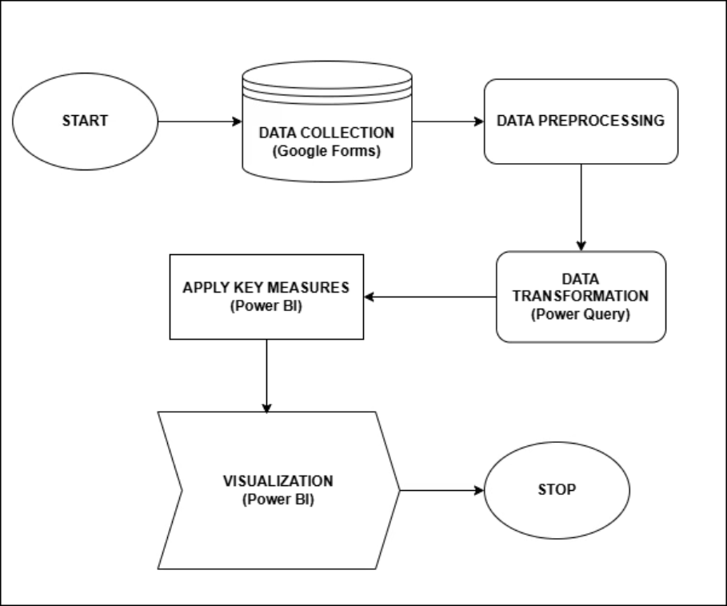
Flow Chart

Slide 8
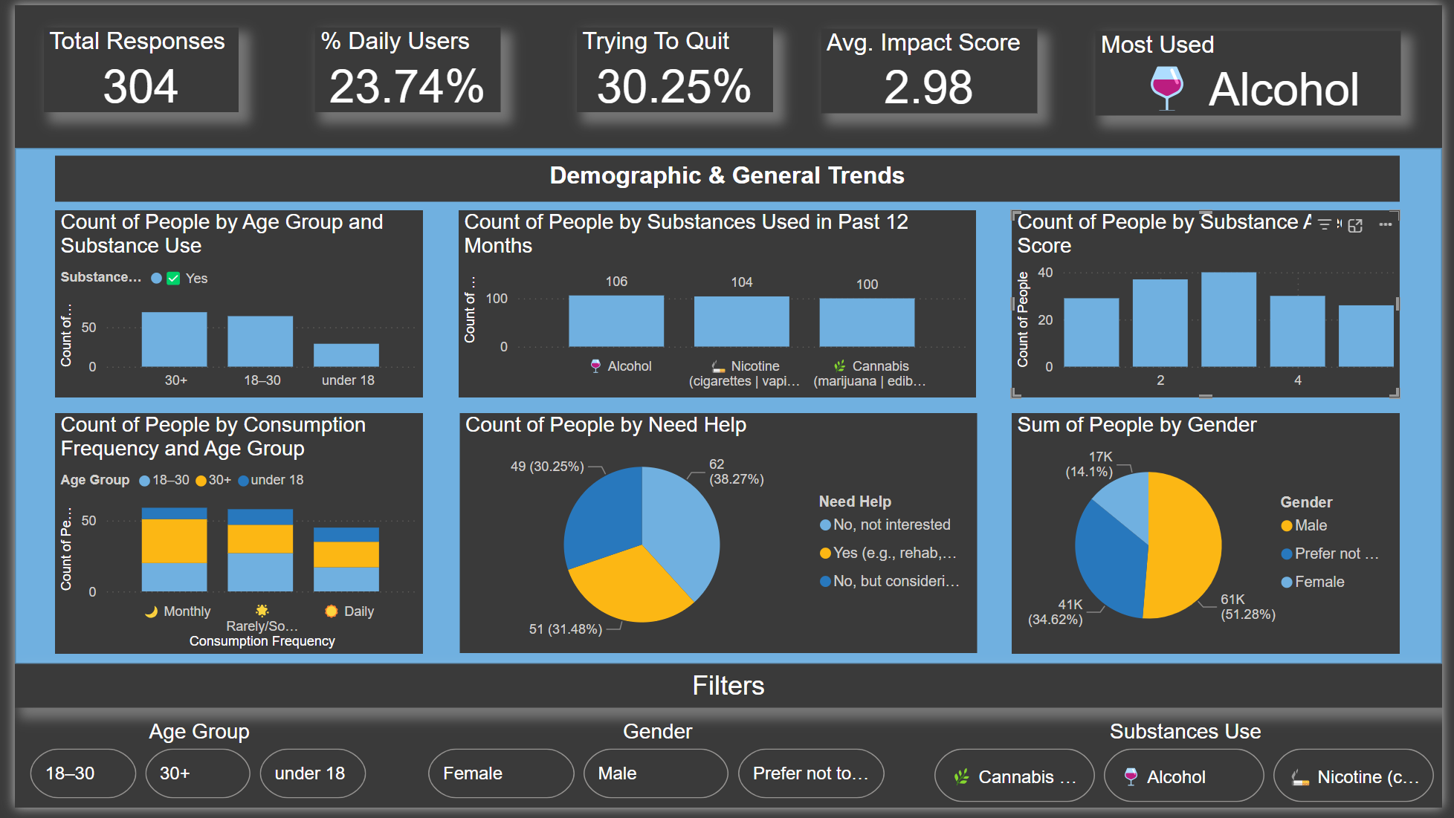
Power BI Dashboard

Slide 9
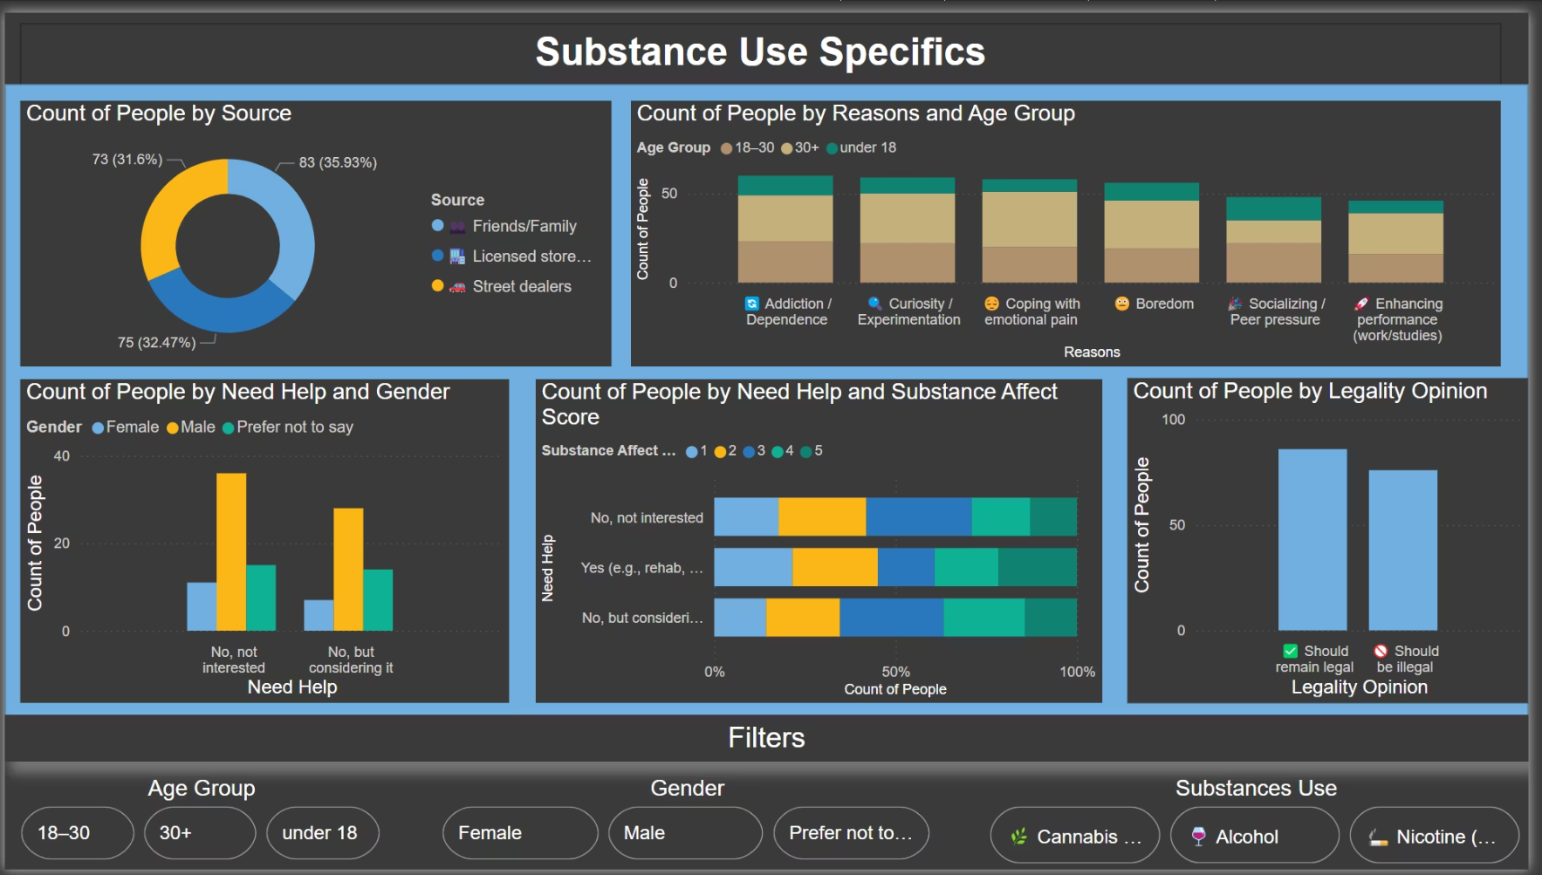
Stress relief, emotional distress, and academic/work pressure were cited as reasons for continued use.
Accessibility to substances was relatively easy.

Slide 10
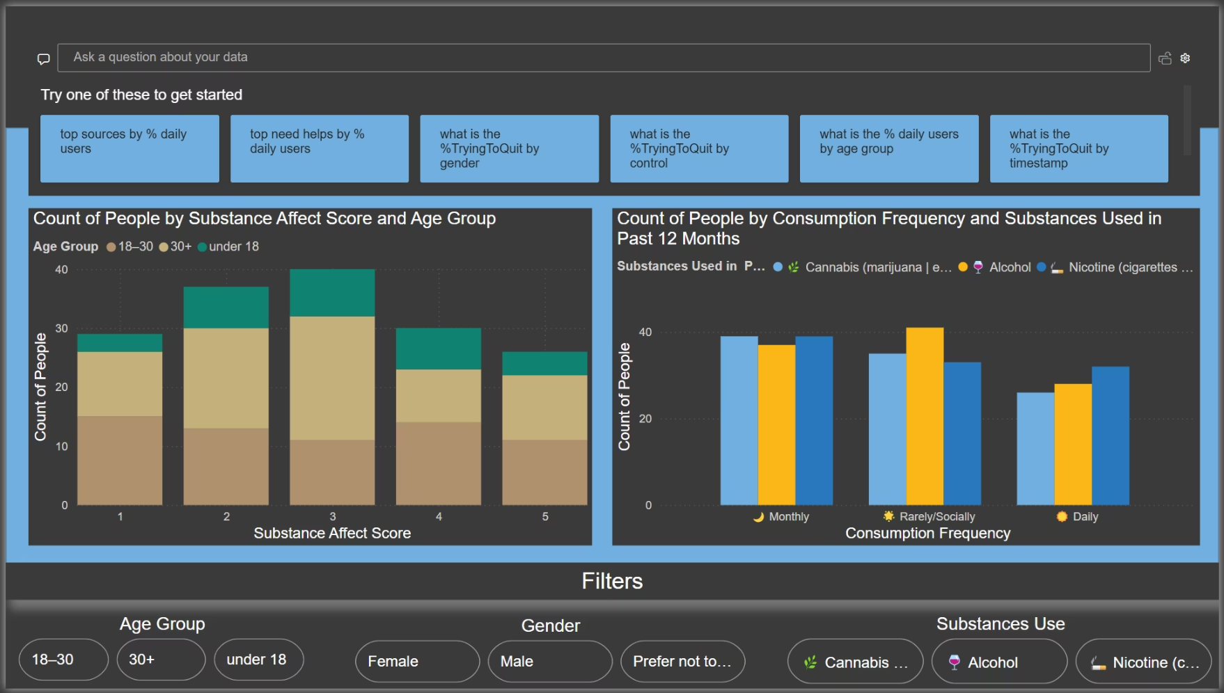

Slide 11
Pros and Cons of the Project
Advantages
Disadvantages
Raises awareness of substance usage patterns.
Potential self-reporting bias
Helps institutions target prevention programs effectively.
Limited sample diversity
Empowers decision-makers with data-backed insights.
Over-dependence on visual data might oversimplify complex behavioral issues.

Slide 12





Challenges & Future Directions
Current Limitations
Sample size and accuracy challenges
Next Steps
Expand dataset and improve quality
Enhancements
Predictive modeling and geospatial mapping
Engagement
Gamified surveys for better participation

Slide 13

Final Insights and Impact
Substance use is common among youth, often influenced by peers, stress, and curiosity
Alcohol and Tobacco emerged as the most consumed substances, followed by Cannabis
Social change
Data drives awareness and intervention.

Slide 14

Sources and Credibility
World Health Organization (WHO) reports
National Family Health Survey (NFHS) data
Power BI technical documentation
Google Forms

Slide 15


